Slide 1
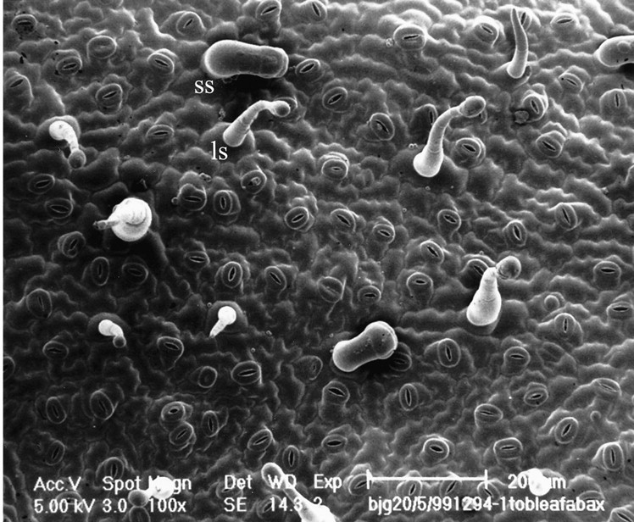
Epidermis-II

Slide 2
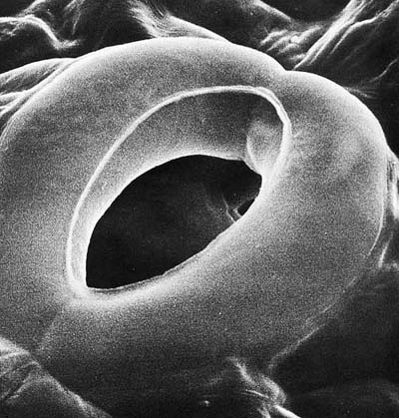
Guard Cells in Cucumber

Slide 3
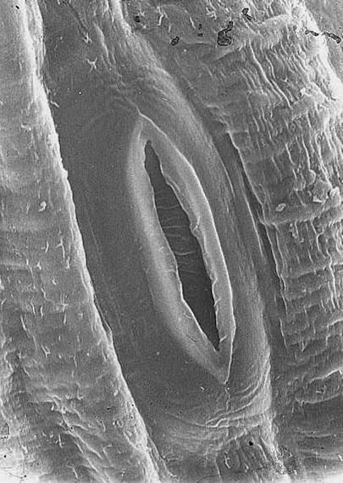
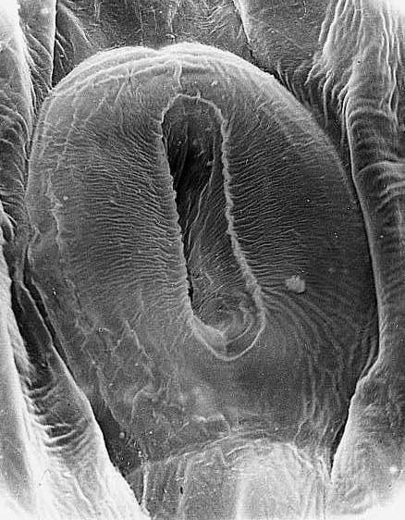
Stomata

Slide 4
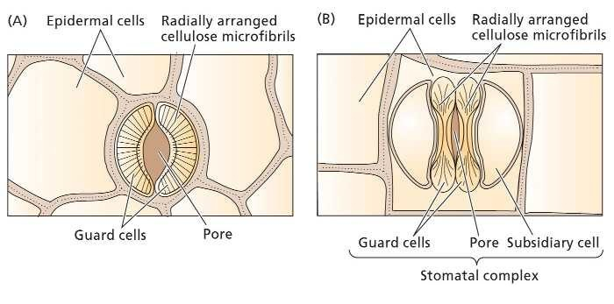
Guard cells

Slide 5
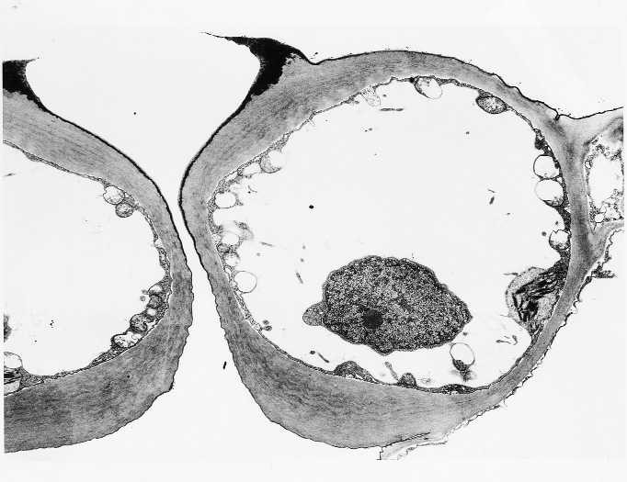
Unevenly thickened wall

Slide 6
Distribution of Stomata
Plant | Average number of stomata/cm²
 | Upper Epidermis | Lower Epidermis
Apple | 0 | 29,400
Black oak | 0 | 58,000
Cabbage | 14,100 | 22,600
Corn | 5,200 | 6,800
Geranium | 1,900 | 5,900
Mulberry | 0 | 48,000
Pea | 10,100 | 21,600
Scarlet oak | 0 | 103,800
Sunflower | 8,500 | 15,600
Wheat | 3,300 | 1,400

Slide 7
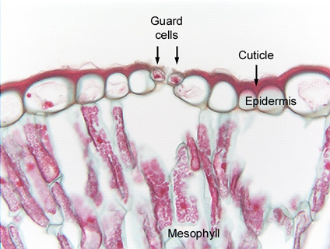
Guard cells level with epidermal cells

Slide 8
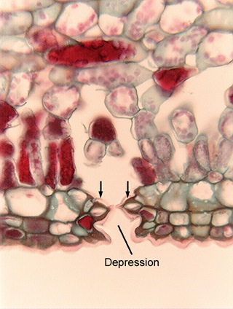
Ficus sunken stoma

Slide 9
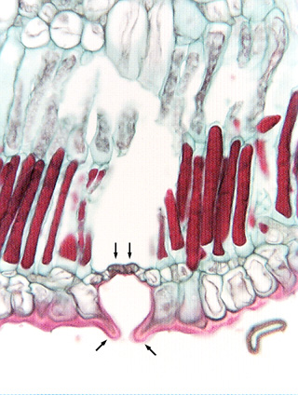
Hakea sunken stoma

Slide 10
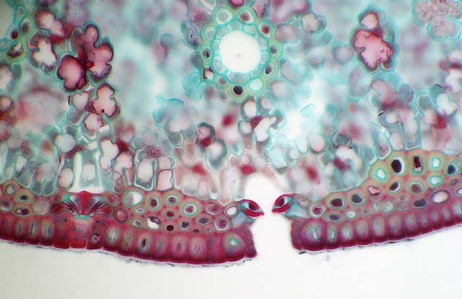
Sunken stoma in pine needle
Also note that epidermal cells are sclerified and fibers occur beneath the epidermis

Slide 11
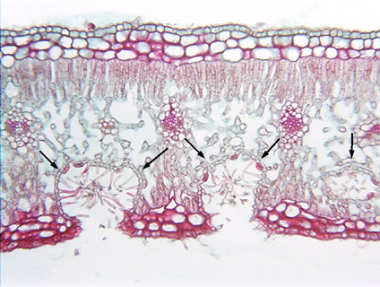
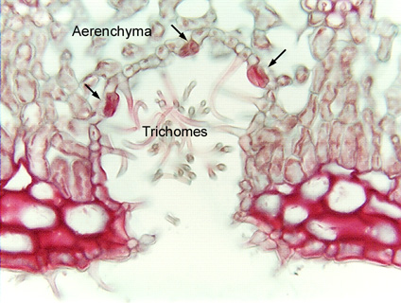
Oleander stomata in crypt

Slide 12
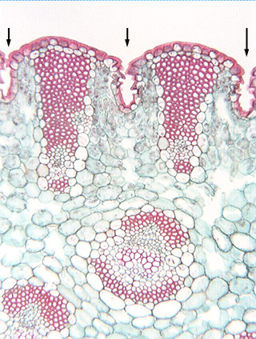
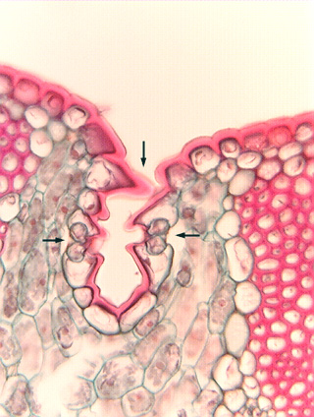
Yucca stomata in channels

Slide 13
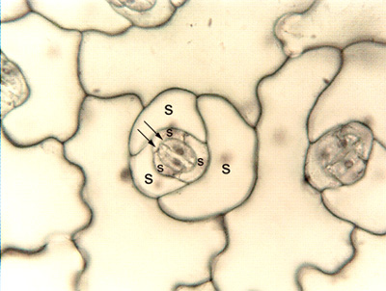
Guard cells and Subsidiary Cells

Slide 14
Stomatal Development
Mesogenous – guard cells and subsidiary cells have a common origin
Perigenous – guard cells and subsidiary cells DO NOT have a common origin
Mesoperigenous – some subsidiary cells have a common origin with guard cells

Slide 15
Some of the common developmental patterns
Anomocytic – no subsidiary cells
Diacytic – two subsidiary cells at right angles to the guard cells
Paracytic – two or more subsidiary cells parallel the guard cells
Actinocytic – subsidiary cells seem to radiate from guard cells
Anisocytic – three unequal-sized subsidiary cells surround the guard cells

Slide 16
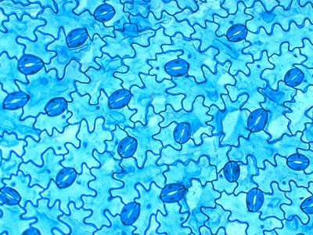
Anomocytic

Slide 17
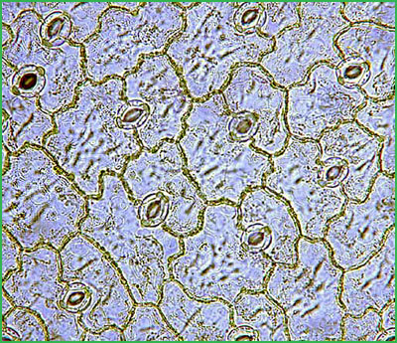
Diacytic

Slide 18
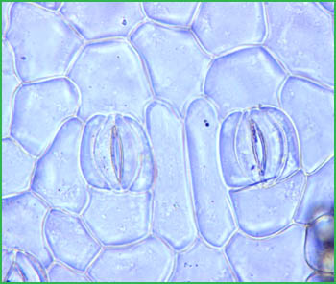
Paracytic

Slide 19
Trichomes
Nonglandular trichomes
  Unicellular trichomes
  Multicellular trichomes
    Uniserate
    Multiserate
    Stellate hairs
    Candelabriform hairs
    Peltate hairs or scales
Glandular trichomes – stalk and glandular head

Slide 20
SEM of tobacco leaf surface

Slide 21
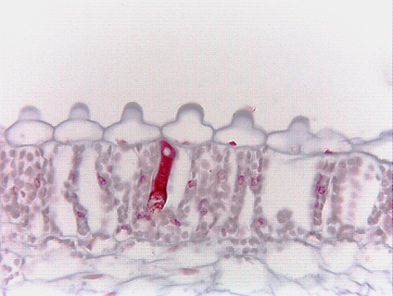
Papillae in Colocasia leaf
Ordinary epidermal cells with papillae or short trichomes?

Slide 22
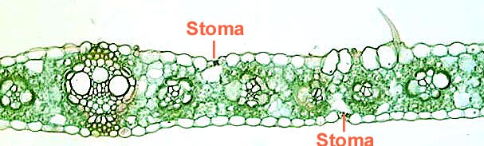
Corn leaf with a unicellular trichome

Slide 23
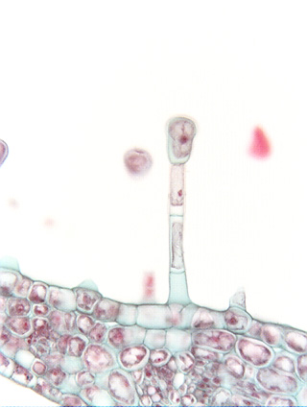
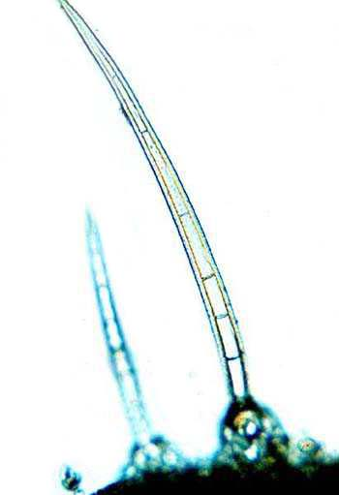
Multicelluar uniserate trichomes

Slide 24
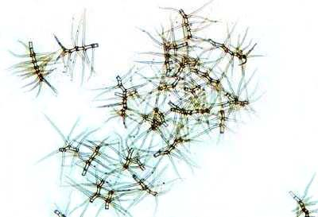
Branched trichomes

Slide 25
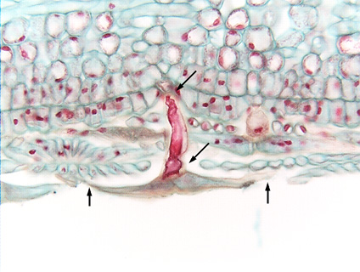
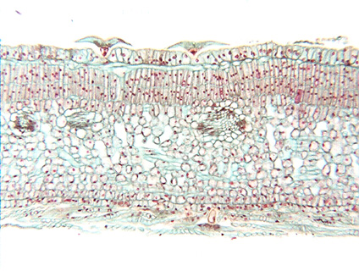
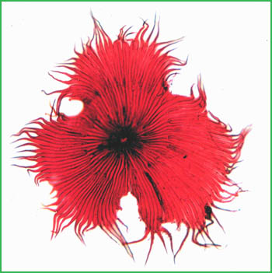
Peltate trichomes in olive

Slide 26
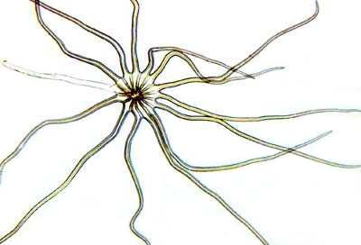
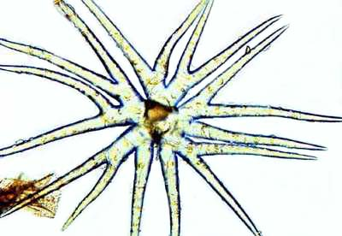
Stellate trichomes

Slide 27
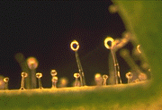
Glandular trichomes in potato leaves

Slide 28
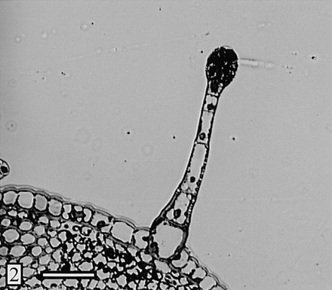
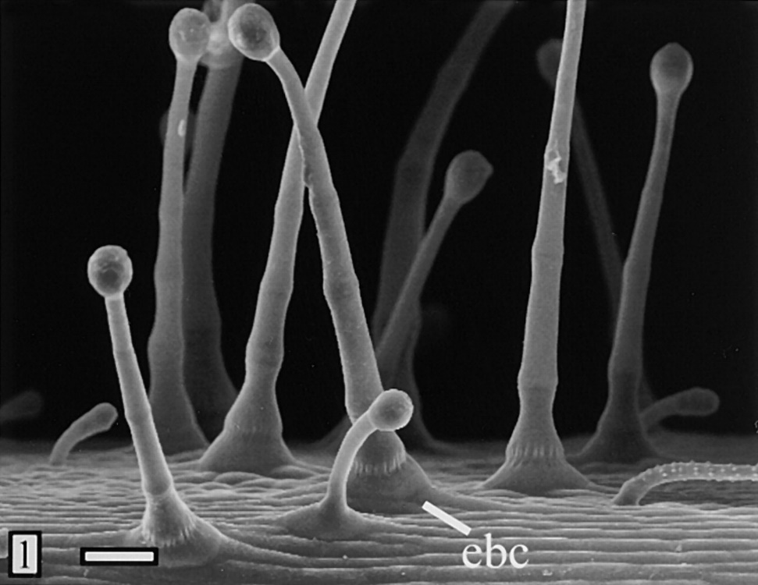
Glandular trichomes in alfalfa

Slide 29
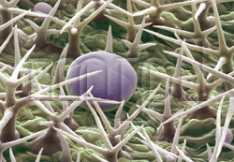
Trichomes in lavender leaves

Slide 30
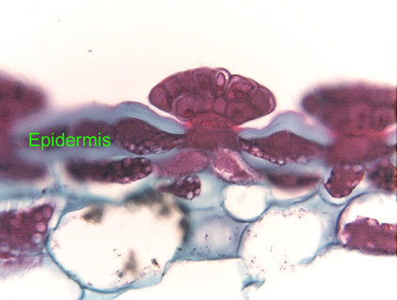
Glandular trichome in Venus fly trap

Slide 31
Unusual Epidermal Cells
Lithocysts
Silica cells and cork cells
Bulliform cells
Multiple epidermis and hypodermis

Slide 32
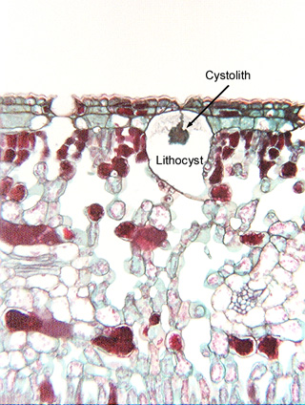
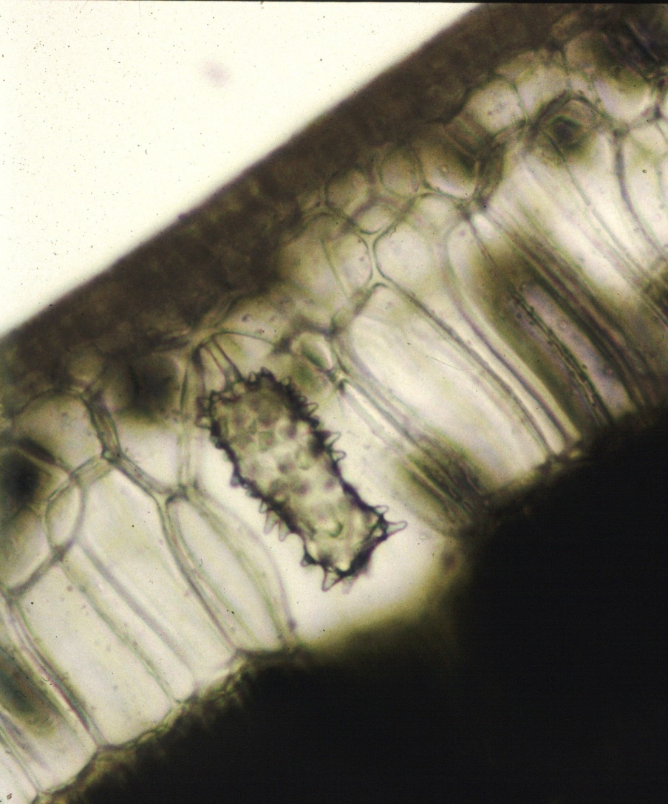
Lithocysts containing a cystolith

Slide 33
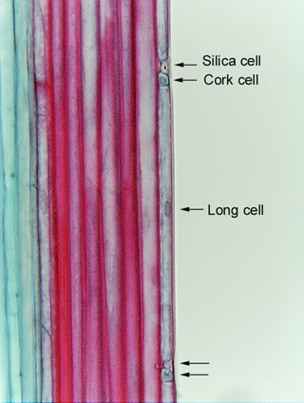
Silica cells and cork cells in grass leaves

Slide 34
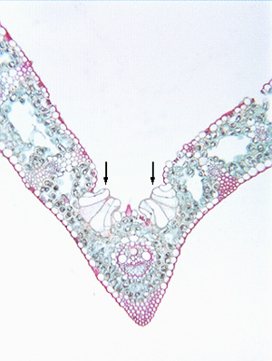
Bulliform cells

Slide 35
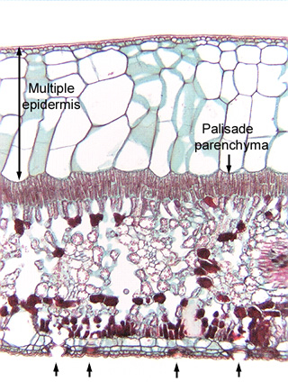
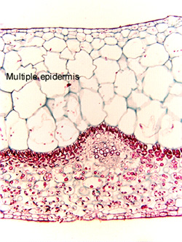
Multiple epidermis

Slide 36
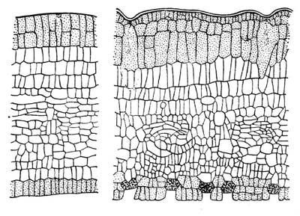
Periclinal divisions in the epidermis give rise to a multiple epidermis

